Slide 1
Pandas
Python + Data Analysis + Panel

Slide 2
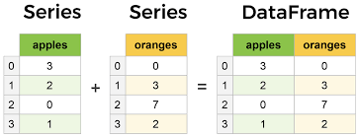
What is a Dataframe?

Slide 3
Numpy and Pandas are best friends
DF is a collection of arrays
Pandas manipulates dataframe
But mathematical calculations are done by Numpy on arrays and each values

Slide 4
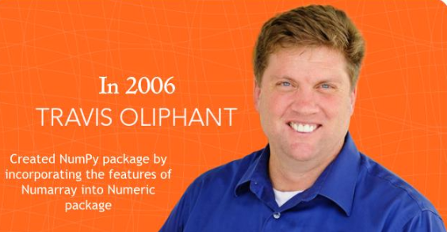
Numpy

Slide 5
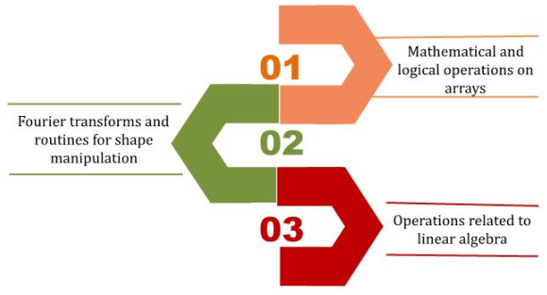
Numpy Operations

Slide 6
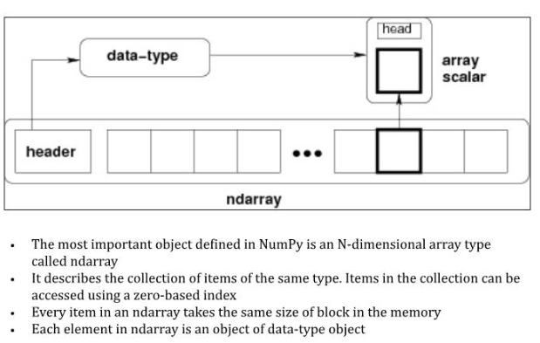
Ndarray Object

Slide 7
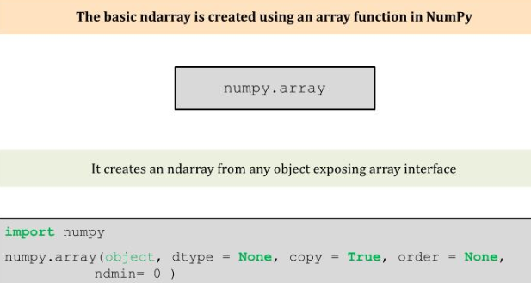
Array Function

Slide 8
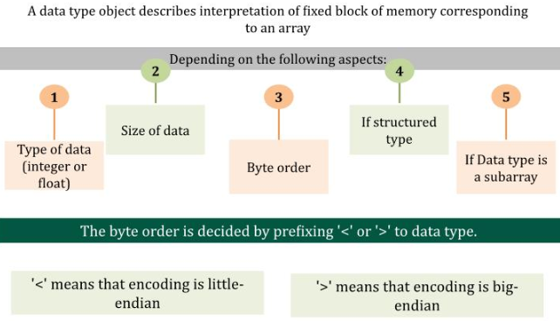
Data Type Objects

Slide 9
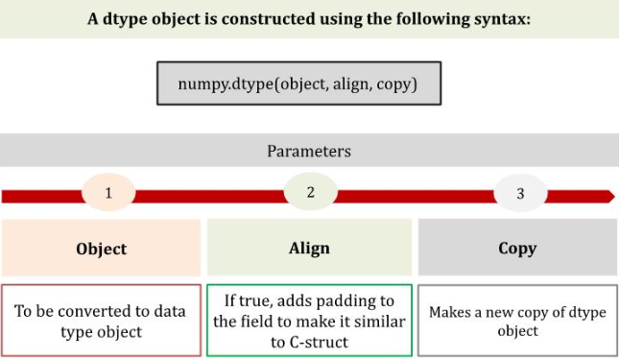
Data Type Objects - Parameters

Slide 10
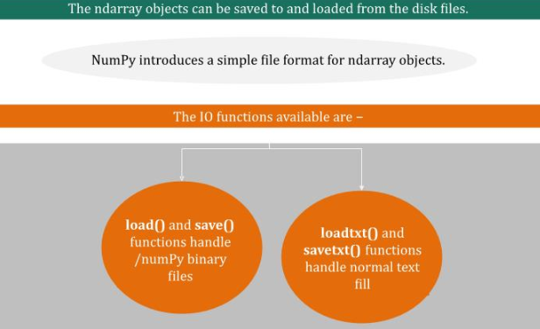
Input / Output with Numpy

Slide 11
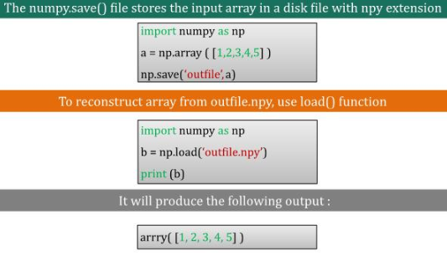
Numpy.save

Slide 12
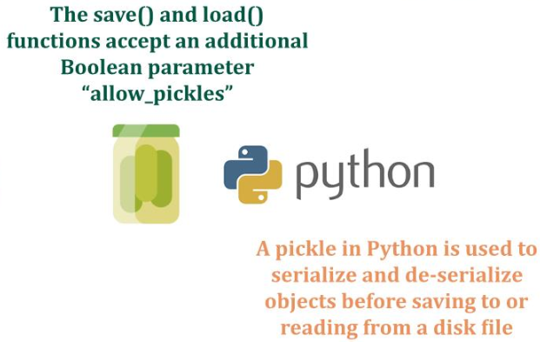
Numpy.save

Slide 13
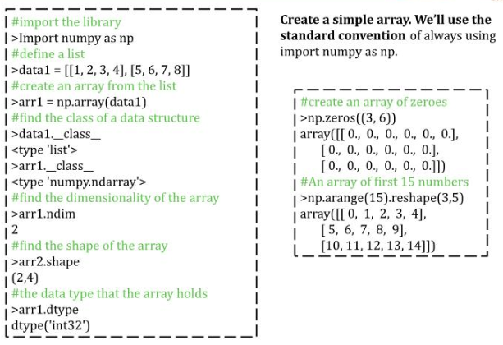
NumPy Arrays

Slide 14
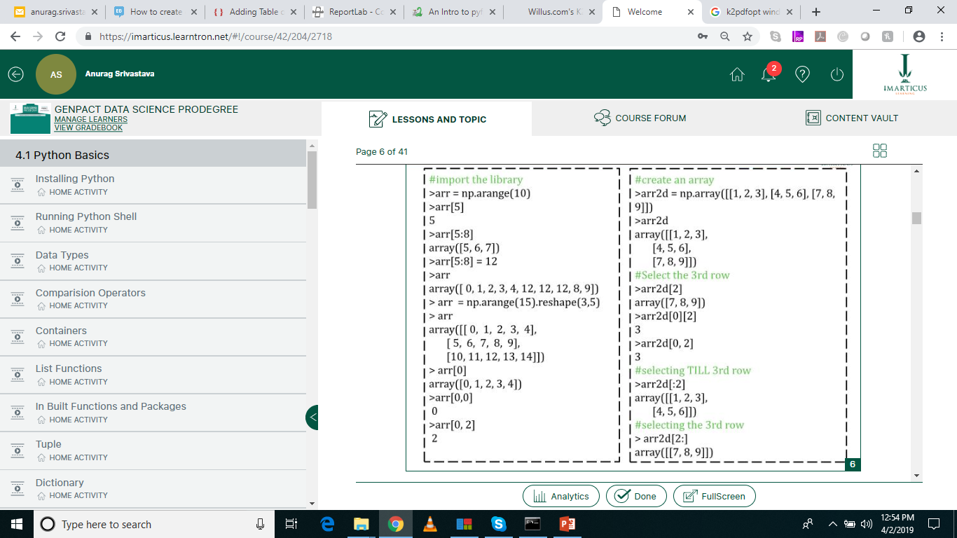
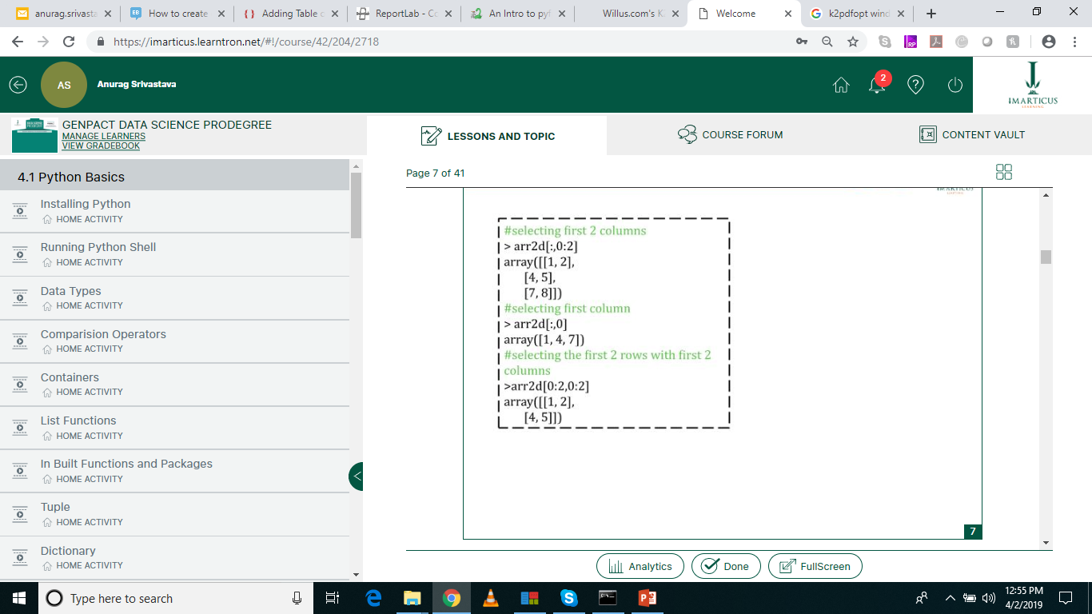
Selecting Columns & Rows

Slide 15
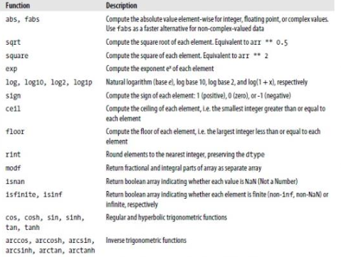
Unary Functions

Slide 16
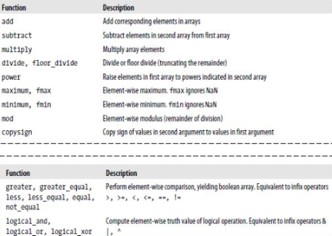
Binary Universal Functions

Slide 17
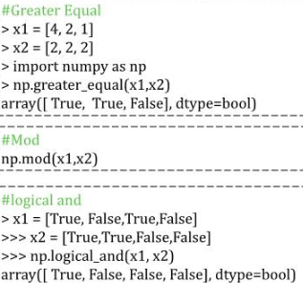
Binary Universal Functions

Slide 18
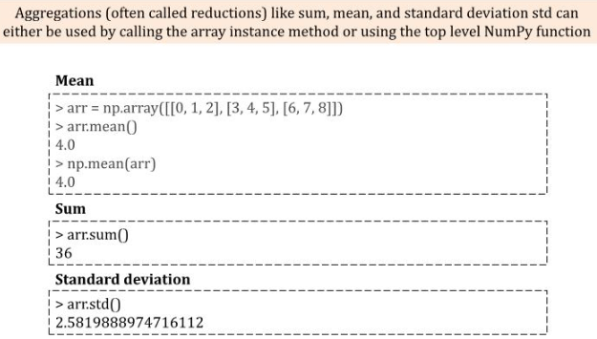
Mathematical & Statistical Functions

Slide 19
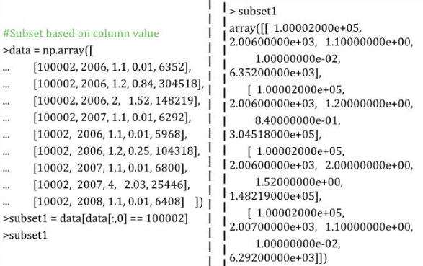
Subsetting Arrays

Slide 20
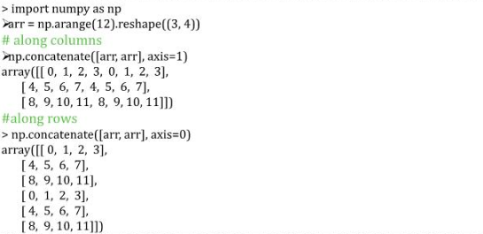
Concatenating Numpy Arrays

Slide 21
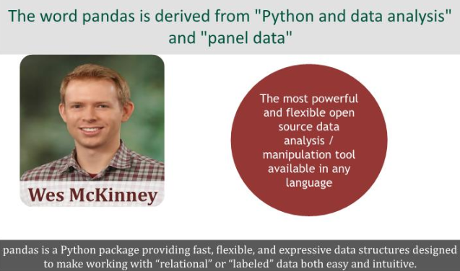
Pandas

Slide 22
Everything about Pandas
https://pandas.pydata.org/

Slide 23
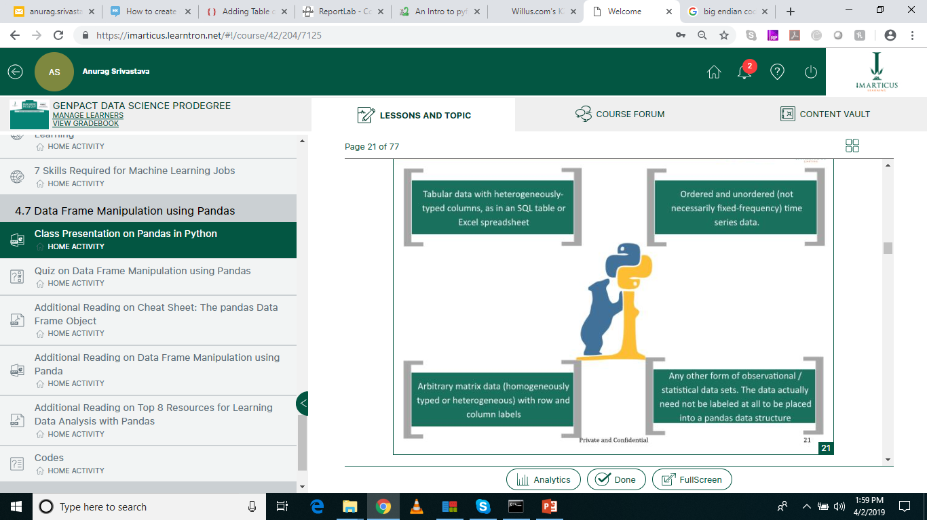
Pandas in Python

Slide 24
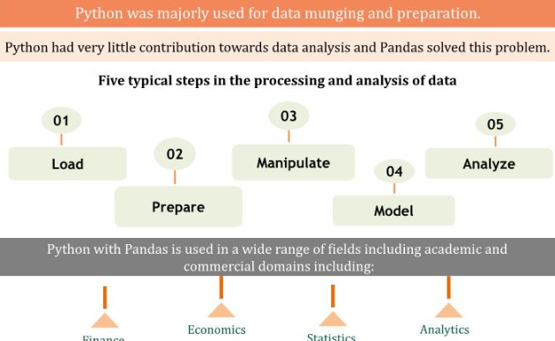
Data Analysis

Slide 25
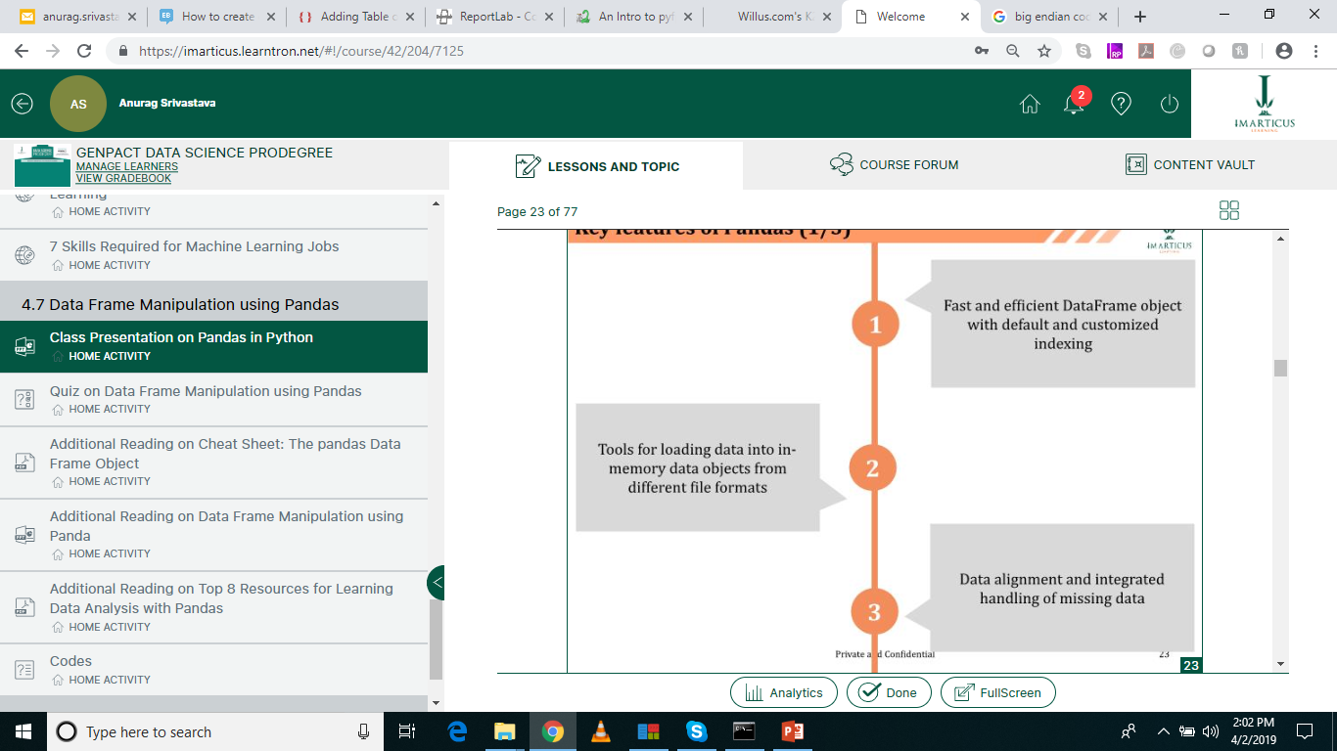
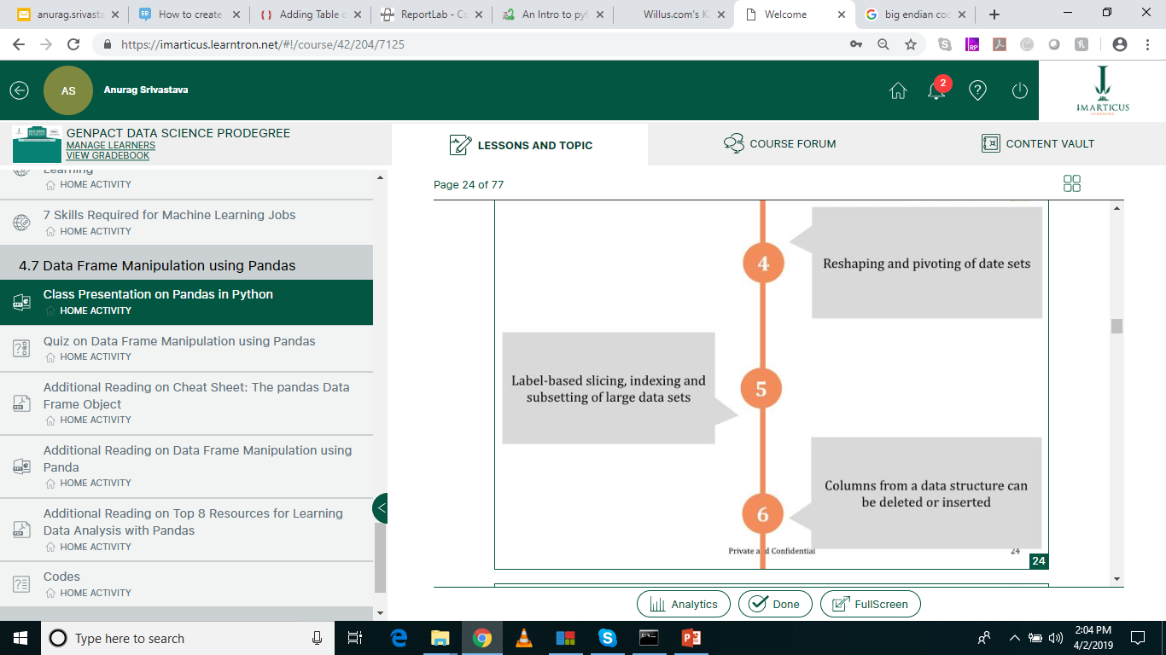
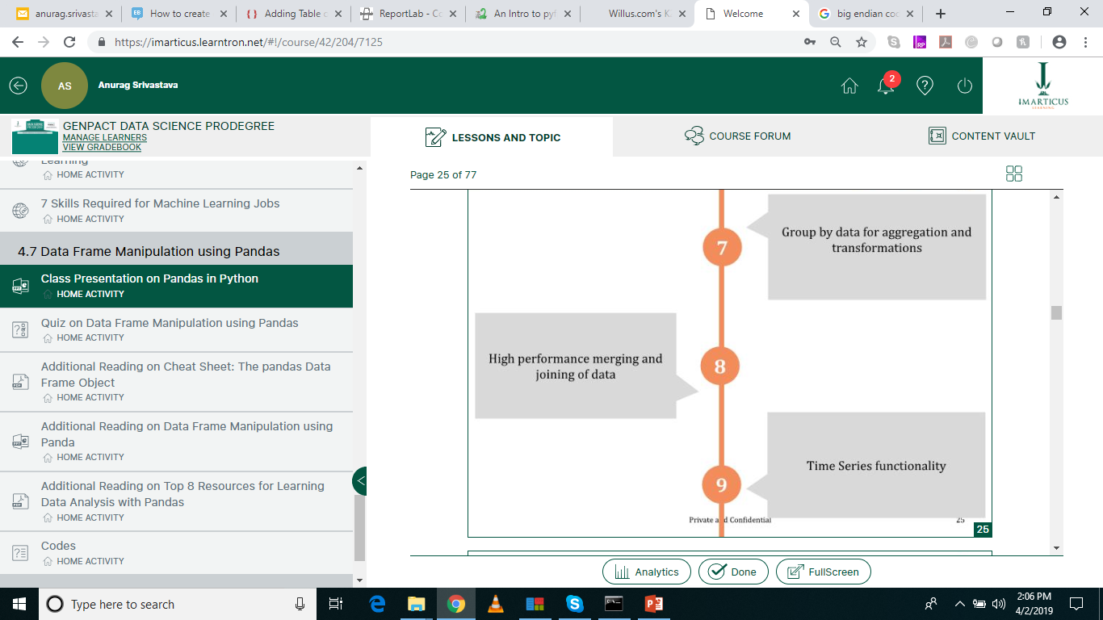
Key Features of Pandas

Slide 26
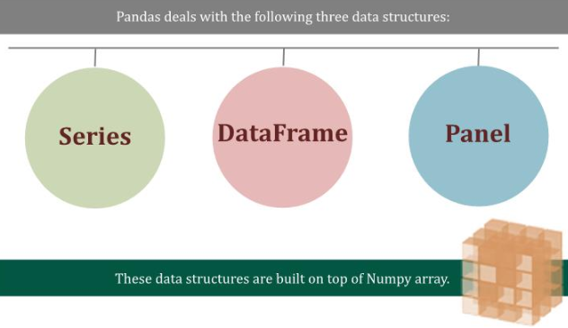
Data Structures in Pandas

Slide 27
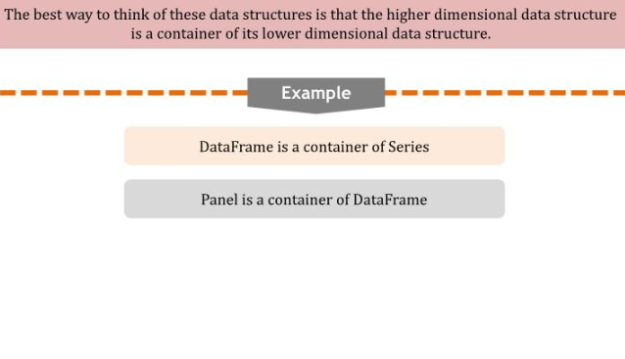
Dimension & Description

Slide 28
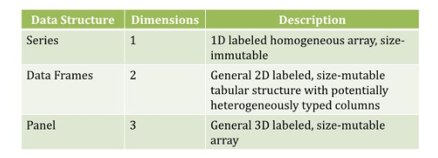
Dimension & Description

Slide 29
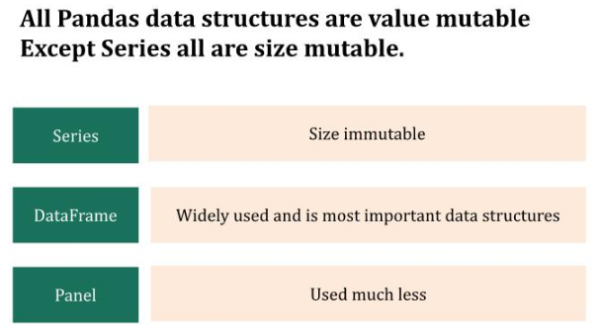
Mutability

Slide 30
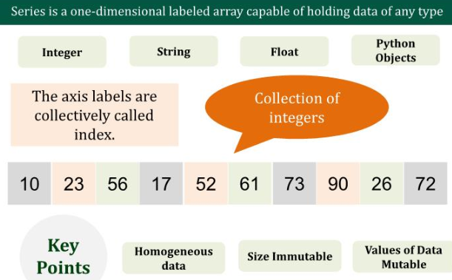
Series

Slide 31
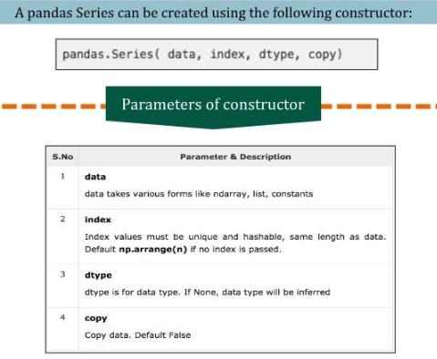
Series

Slide 32
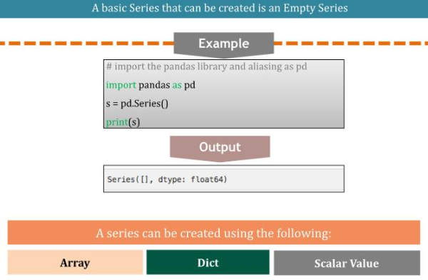
Series

Slide 33
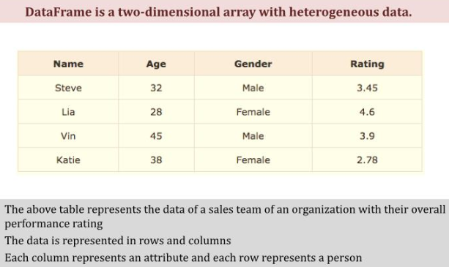
Dataframe

Slide 34
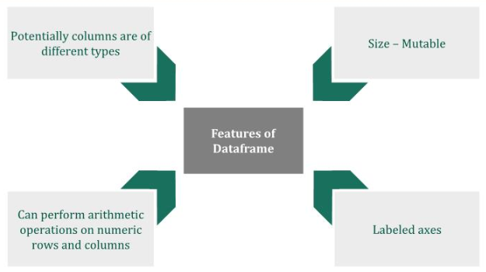
Features of Dataframe

Slide 35
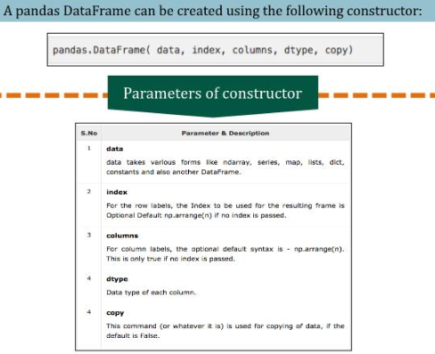
Pandas Dataframe

Slide 36
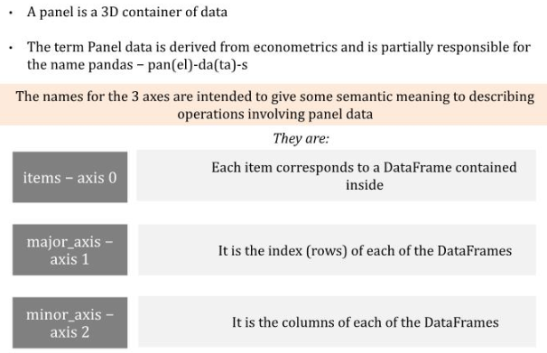
Panel

Slide 37
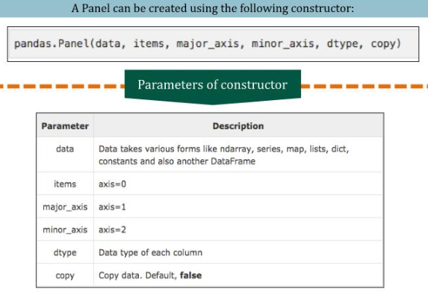
Pandas Panel

Slide 38
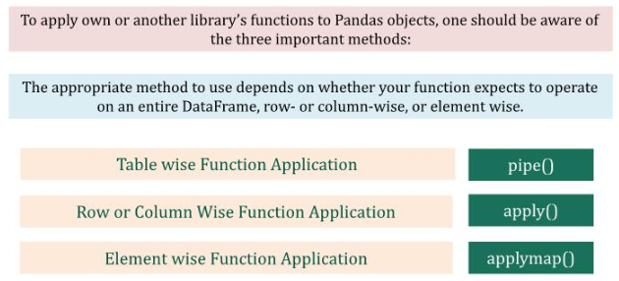
Function Application

Slide 39
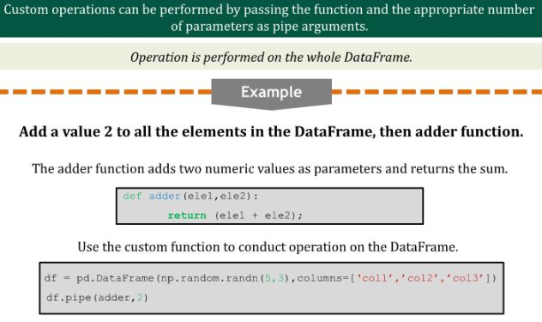
Table wise function application

Slide 40
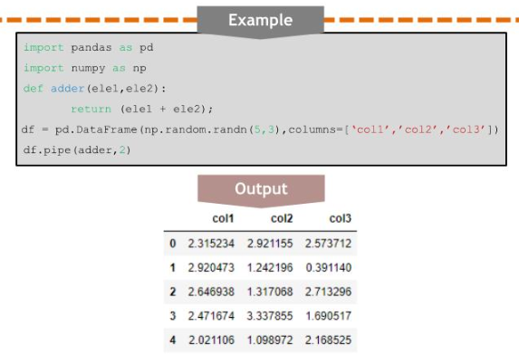
Table wise function application

Slide 41
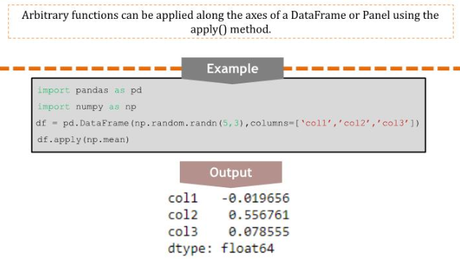
Row or Column wise function application

Slide 42
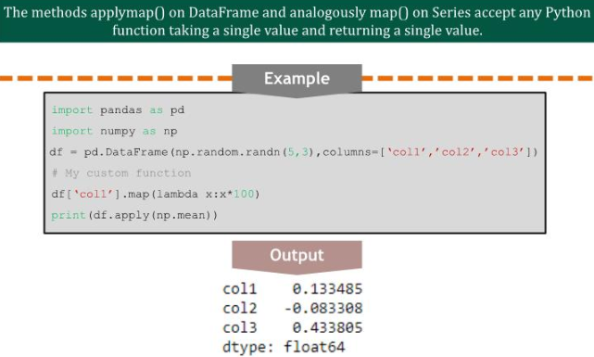
Element wise function application

Slide 43
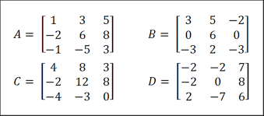
Indexing
Index is like an address, that’s how any data point across the dataframe or series can be accessed. Rows and columns both have indexes, rows indices are called as index and for columns its general column names.
What is A_{2,3}? B_{1,1}? C_{3,2}? D_{2,2}?

Slide 44
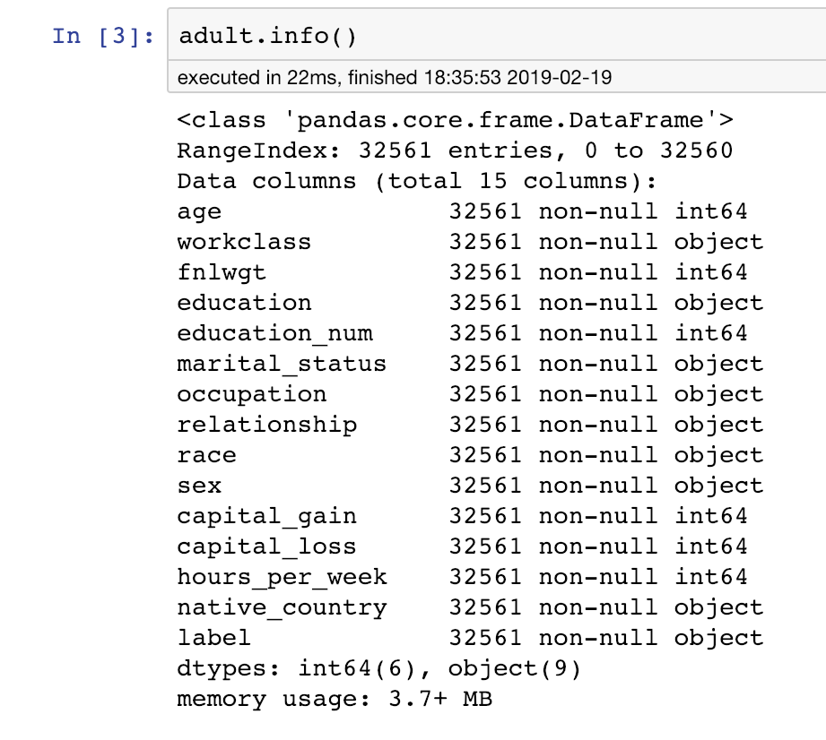
Indexing
Similarly for a dataset –
Sr. No. is the index i.e. which column is at which position
And total number of rows

Slide 45
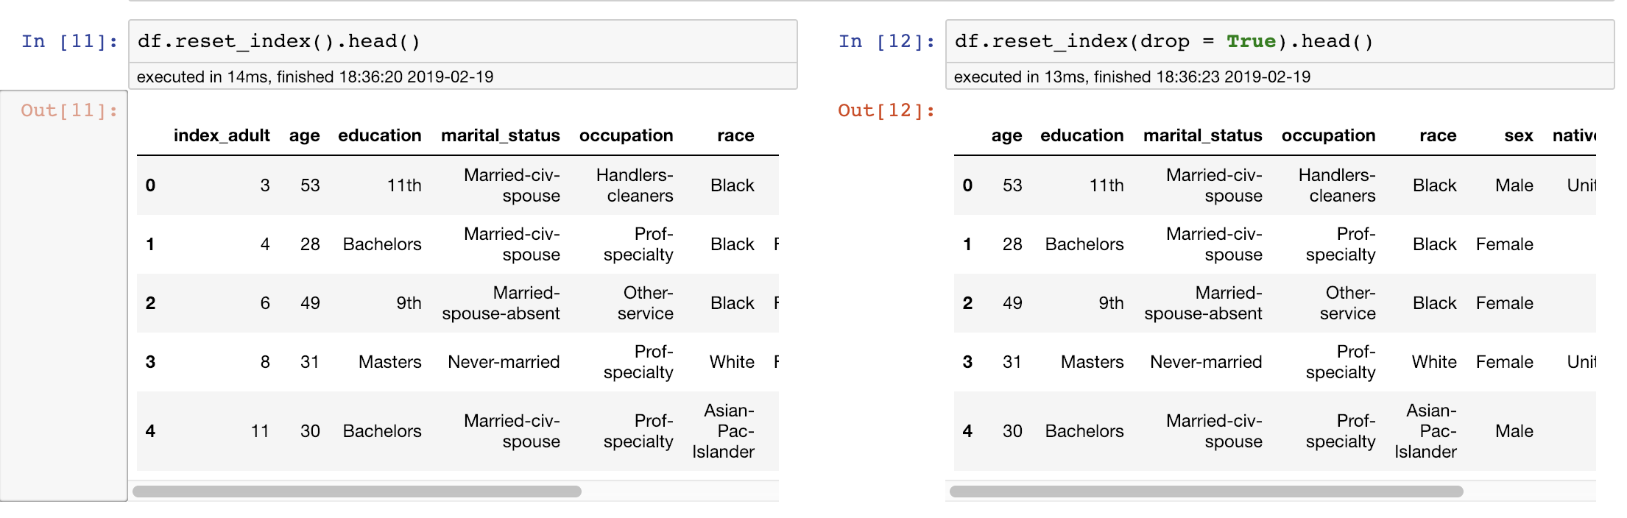
Index is NOT a separate column in DF

Slide 46
Indexing – Normal and Hierarchical / Multi Indexing
Normal – The address (what we saw in previous slides)
Hierarchical – array of tuples where each tuple is unique. OR incorporate multiple index levels within a single index.
https://pandas.pydata.org/pandas-docs/stable/user_guide/advanced.html

Slide 47
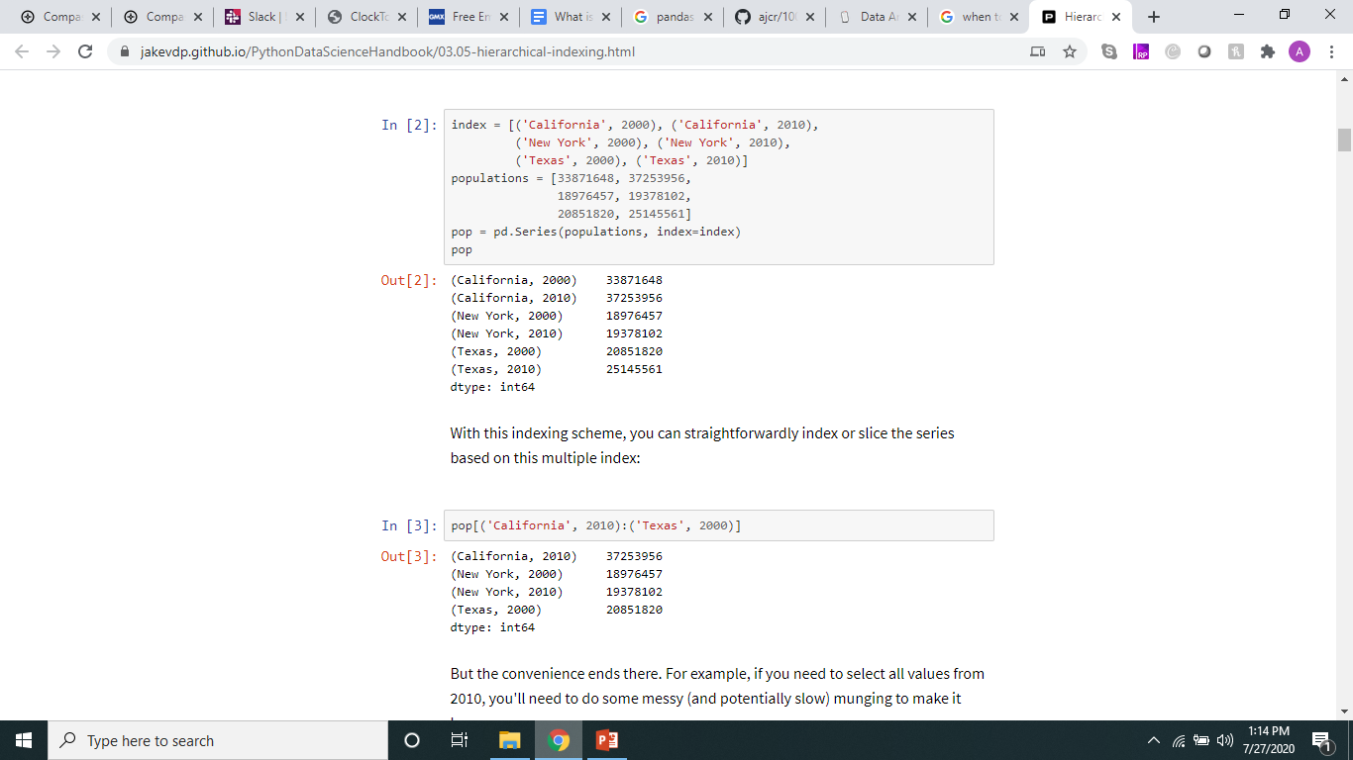
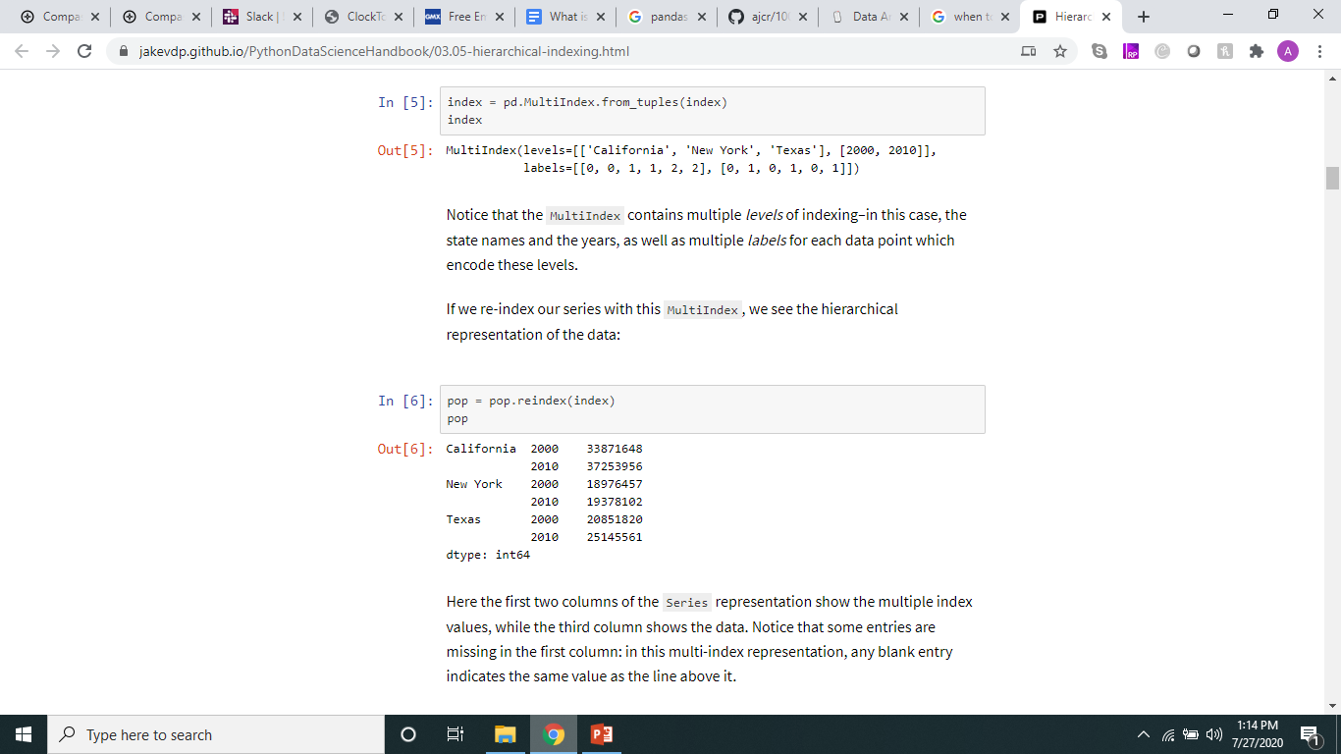
When Multi – Index is useful?

Slide 48
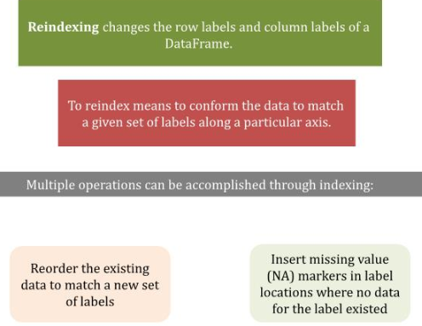
Reindexing - Alignment

Slide 49
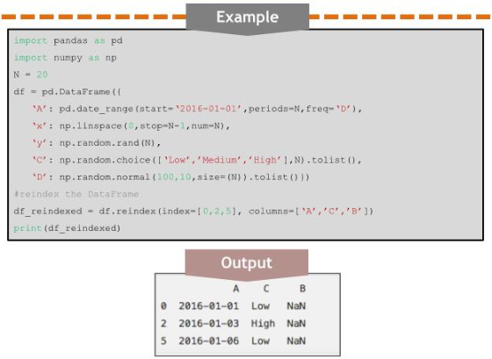
Reindexing

Slide 50
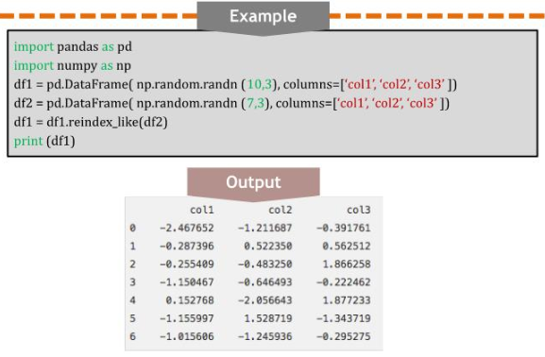
Reindexing to align with other objects

Slide 51

Filling while reindexing

Slide 52

Filling while reindexing

Slide 53

Limits on filling while reindexing

Slide 54

Renaming

Slide 55

Read a .csv file

Slide 56

Mark column as index column

Slide 57
Slicing
https://datacarpentry.org/python-ecology-lesson/03-index-slice-subset/index.html
Download data from - https://ndownloader.figshare.com/files/2292172

Slide 58
Why vectorization is faster?
https://www.experfy.com/blog/why-you-should-forget-loops-and-embrace-vectorization-for-data-science/
Reason - https://stackoverflow.com/questions/35091979/why-is-vectorization-faster-in-general-than-loops

Slide 59

Column type conversion

Slide 60

Assign header names to columns

Slide 61

Skip rows in a dataframe

Slide 62

Referencing

Slide 63

Selecting columns and rows

Slide 64

Filtering

Slide 65

Dropping rows and columns

Slide 66

Handling missing data

Slide 67

Filtering out missing data

Slide 68

Filtering out missing data

Slide 69

Combining & merging datasets

Slide 70

Combining and merging datasets

Slide 71

Combining and merging datasets

Slide 72

Concatenating dataframes

Slide 73

Removing duplicates

Slide 74

Removing duplicates

Slide 75

Dicretization and Binning

Slide 76

Discretization and Binning

Slide 77
Questions?
Thank you!

